Slide 1





Role Of Women in Economy

Slide 2

Project By :
Siddharth Singh
Ajay Dikondwar
Uday Paspule
Punam Gaware
Vishal Pawar
Project Guide :
Ms. Vanita Mhaske

Slide 3
Data Sources:
World Data Bank
https://data.worldbank.org/indicator/SL.TLF.ACTI.FE.ZS?locations=IN
Our world in Data
https://ourworldindata.org/female-labor-force-participation-key-facts
R Software
R Studio
MS Excel
Statistical Tools:

Slide 4
Overview
One of the major factor that USA is developed and China is near about developed country in the world is due to contribution of women in their particular economies. Now a days we are seeing the increased number of women's in all the sectors of economy with immediate results in a positive manner. If we scrutiny between the work of women in comparison with men we will get that women are more skill-full. Besides physical difference, there is no any other significant factor can affect their work. If we look towards Indian population we realize that there is astonishingly large number of women and if we utilize this population in creative and productive manner, we will get positive outlook in terms of economic development.

Slide 5
Objectives
To identify trends and pattern of changes in women’s employment structure over years consequent upon the structural changes in the Indian Economy.
To analyze India’s growth towards Sustainable Developmental Goal(SDG)-5 & 8.
To provide a way to cope-up with the economic collapse we faced in the recent pandemic.
To examine how severe is the problem of Gender Disparity in India.

Slide 6
Sample 1
Where Do We Stand ?
Germany
China
Mecklenburg-Vorpommern
Schleswig-Holstein
Hamburg
Heilongjiang
Jilin
GDP- 14.14 Trillion
FLPR – 60.5%
Bremen
Xinjiang
Inner Mongolia
GDP- 3.86 Trillion
FLRP- 55.3%
1
Niedersachsen
Berlin
Beijing
Liaoning
Brandenburg
Tianjin
Nordrhein-Westfalen
Sachsen-Anhalt
Qinghai
Ningxia
Hebei
Jiangsu
[0 to 100[
Shanxi
Shandong
[100 to 200[
Thüringen
Sachsen
Gansu
Henan
[200 to 300[
Hessen
Xizang
Shaanxi
[300 to 400[
400+
1
Sichuan
Hubei
Anhui
Shanghai
400+
United States
400+
Rheinland-Pfalz
Chongqing
400+
Zhejiang
1
Hunan
Jiangxi
400+
400+
1+
Guizhou
Fujian
Saarland
Bayern
< 1
Yunnan
[200 to 300[
Guangxi
Guangdong
[300 to 400[
Maine
400+
Washington
Vermont
Baden-Württemberg
400+
Minnesota
New Hampshire
400+
Montana
North Dakota
400+
1
Oregon
Massachusetts
400+
Hainan
Wisconsin
New York
400+
Idaho
South Dakota
Michigan
Rhode Island
Wyoming
Pennsylvania
Connecticut
Nevada
Nebraska
Iowa
Ohio
New Jersey
Indiana
Delaware
Utah
Colorado
Illinois
Virginia
Maryland
Japan
California
Kansas
Missouri
Kentucky
Washington DC
North Carolina
Tennessee
West Virginia
GDP- 5.1 Trillion
FLPR- 52.7%
India
GDP- 2.94 Trillion
FLPR- 20.5%
Arizona
New Mexico
Oklahoma
Arkansas
Alabama
1
Jammu and Kashmir
Mississippi
Georgia
South Carolina
Texas
Louisiana
[0 to 100[
1
Alaska
Florida
[100 to 200[
[200 to 300[
[300 to 400[
[0 to 100[
400+
[100 to 200[
400+
[200 to 300[
Chandigarh
Hawaii
400+
[300 to 400[
400+
Punjab
Himachal Pradesh
1
400+
400+
400+
Uttarakhand
Arunachal Pradesh
400+
400+
400+
Haryana
Delhi
Sikkim
1
400+
Rajasthan
Uttar Pradesh
Assam
400+
Bihar
Nagaland
GDP- 21.44 Trillion
FLPR- 56.1%
Jharkhand
Meghalaya
Manipur
Madhya Pradesh
Gujarat
Mizoram
1
Orissa
Tripura
Daman and Diu
Maharashtra
West Bengal
Dadra and Nagar Haveli
Telangana
Chhattisgarh
1+
Andhra Pradesh
< 1
Goa
[200 to 300[
[300 to 400[
400+
Karnataka
400+
Puducherry
400+
400+
Andaman and Nicobar
1
Kerala
Tamil Nadu
400+
Lakshadweep
400+

Slide 7

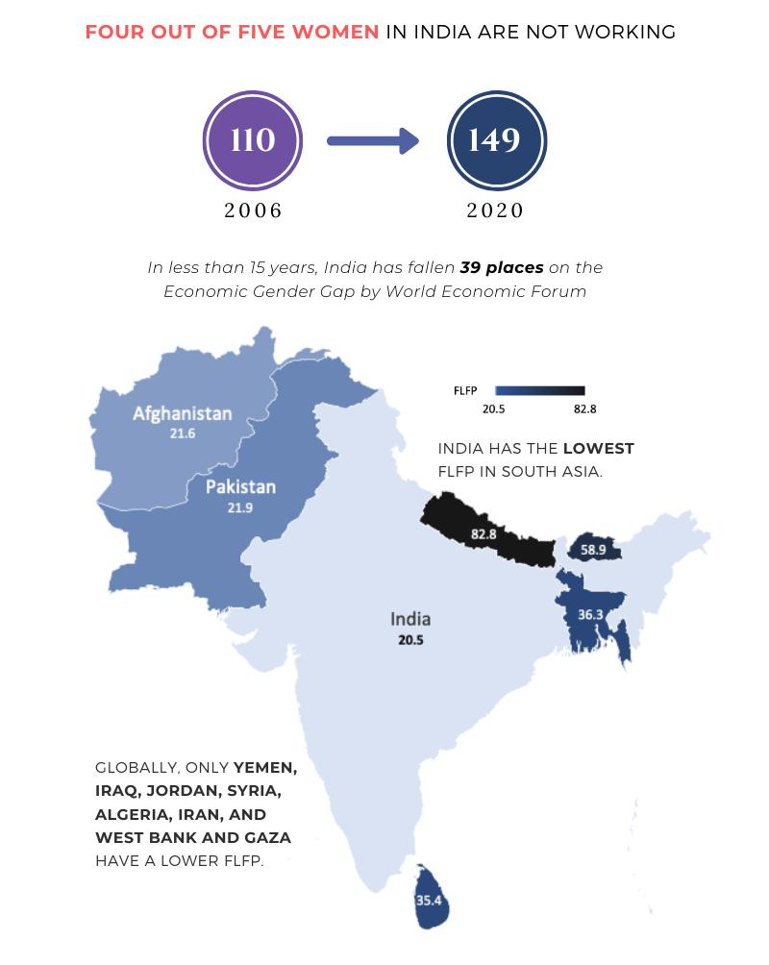

Slide 8
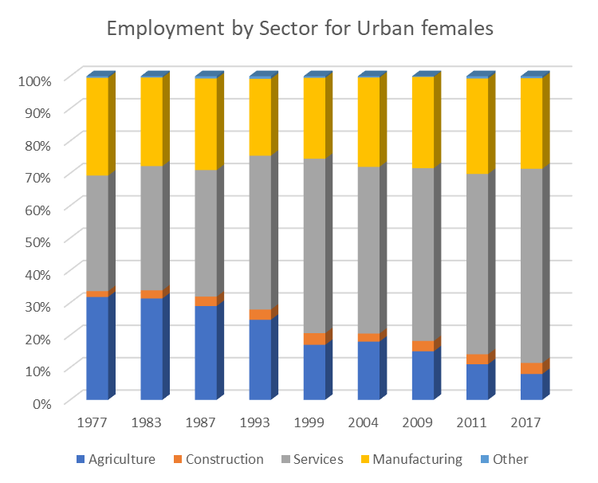
Employment by Sector in Urban
Initially in 1960 s the women sector in urban area were also involved mainly in agriculture . This may be due to their primary source of income. Although from 1990 onwards their involvement began to decline & fell down by 7-8 % due to new mechanisation of agriculture and security risks.
Contribution to construction sector by urban females were less initially about 2-3% due to less land availability. But it gradually increases from last 3 decades up to 5%.
In Service sector the contribution of urban females has increased significantly from 1970 to the present. This happens to be obvious since this sector provides a diversified jobs such as teaching, nursing, lawyer etc. along with good pay scale.
Manufacturing sector has not seen any remarkable growth over the decades & has remained constant in some extent because increased in home-based work for women as part of outsourced employment.

Slide 9
Employment by Sector in Rural
In rural sector the main occupation for the livelihood is agriculture. And “GREEN REVOULUTION” brings the more opportunities in farm sector during 1960-80. Henceforth most of the population is engaged with the agricultural activities hoeing ,weeding ,grass cutting etc. this is the reason why involvement of females in this sector is most which is up to 85-90%
There is only 1.5% - 5% involvement of women in construction sector in rural area because they unable to acquire specific skills related to construction area.
The involvement of women in service sector is very less which is 5 -8% only. This is due to fact that availability of formal jobs is very less in rural sector. Also these jobs require certain skills to be acquired which is not preferred by the females and they tend to go towards unskilled labour jobs.
Besides these many social and cultural barriers are also faced by them which inherently decreases their contribution . Also the wages received by them is less as compared to men in different sectors.

Slide 10
Share of India's Female Labour Force by Sector
In the year 2018-19 about 20.7% of women were involved in labour force across in India. The female labour force is an important indicator that reflects the economy active work force.
Overall 63% of the population in India is merged in agricultural activities . agriculture is the engine of growth & poverty reduction. As per the data given by world bank about 17.5% of India GDP is accounted by means of agricultural production. So their percentage become high in both rural and urban area.
Participation of women in manufacturing sector in only 13% . It is observed that there is unawareness among women about the job opportunity in this sector. This leads to condition for women participation in this sector have worsened significantly.
Construction is the second largest industry in India after agriculture. However involvement of manpower is not so significant. Still this sector adds to GDP as well as generates an employment in significant terms .women still don’t try to seek for the jobs in this sector due to environmental & cultural barriers. Hence their percentage is low(6%).
A more skilled women would have more potential to increase their earning resulting in an increase in labour participation, via education. But graph shows us that only 4% share of women in education sector. This may be due to the fact that this sector requires most of its employed to be skilled.
The retail and wholesale sector is very important in terms of both economic size and social impact. Share of the women in this sector is only 4% due to the broad cluster of trends such as demographic structure , economic trend , environmental challenges etc.

Slide 11
Factors Affecting FLPR
Fertility Rate
Gender Gap
Frequent Pregnancies
Maternity Leave
Disruption of life
Male Dominance
Restriction on Women’s Employment.
Literacy Rate
Social Exploitation
Social Poverty
Burden on Women
Income Poverty
No scope for Progress.
Quality Education
Maternal Mortality Rate
Security
. Maternal mortality refers to deaths due to complications from pregnancy or childbirth.
Office Environment
Inappropriate Behavior
Abusement
Violence

Slide 12
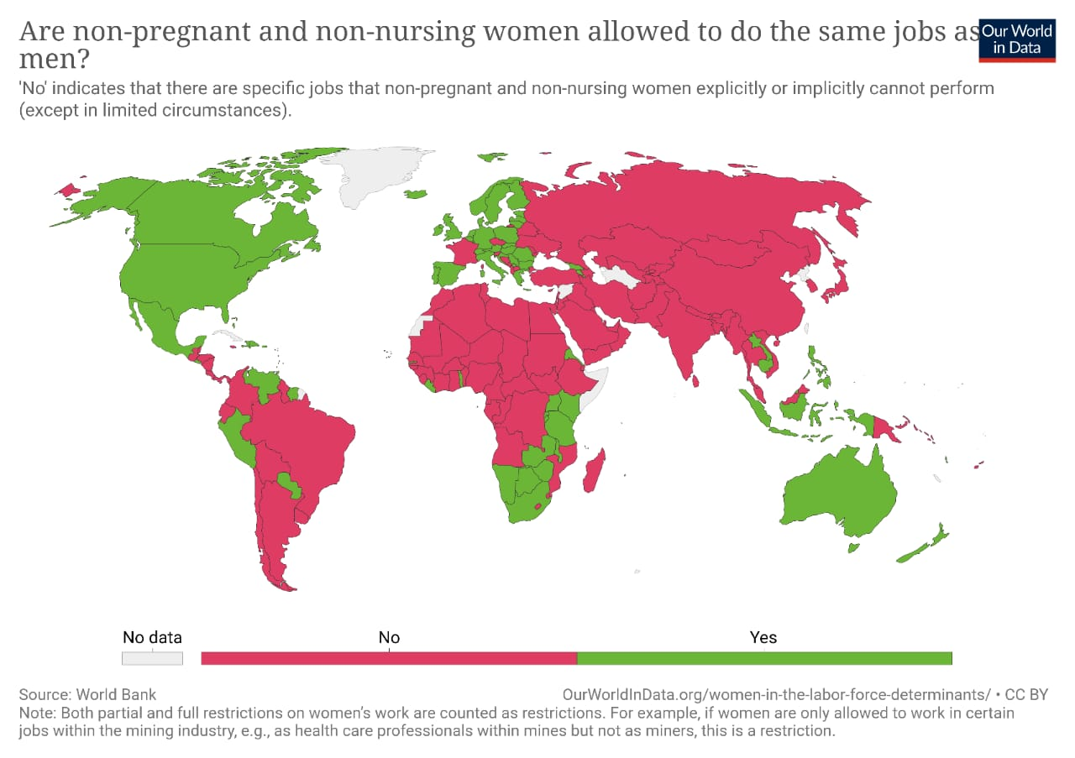

Slide 13
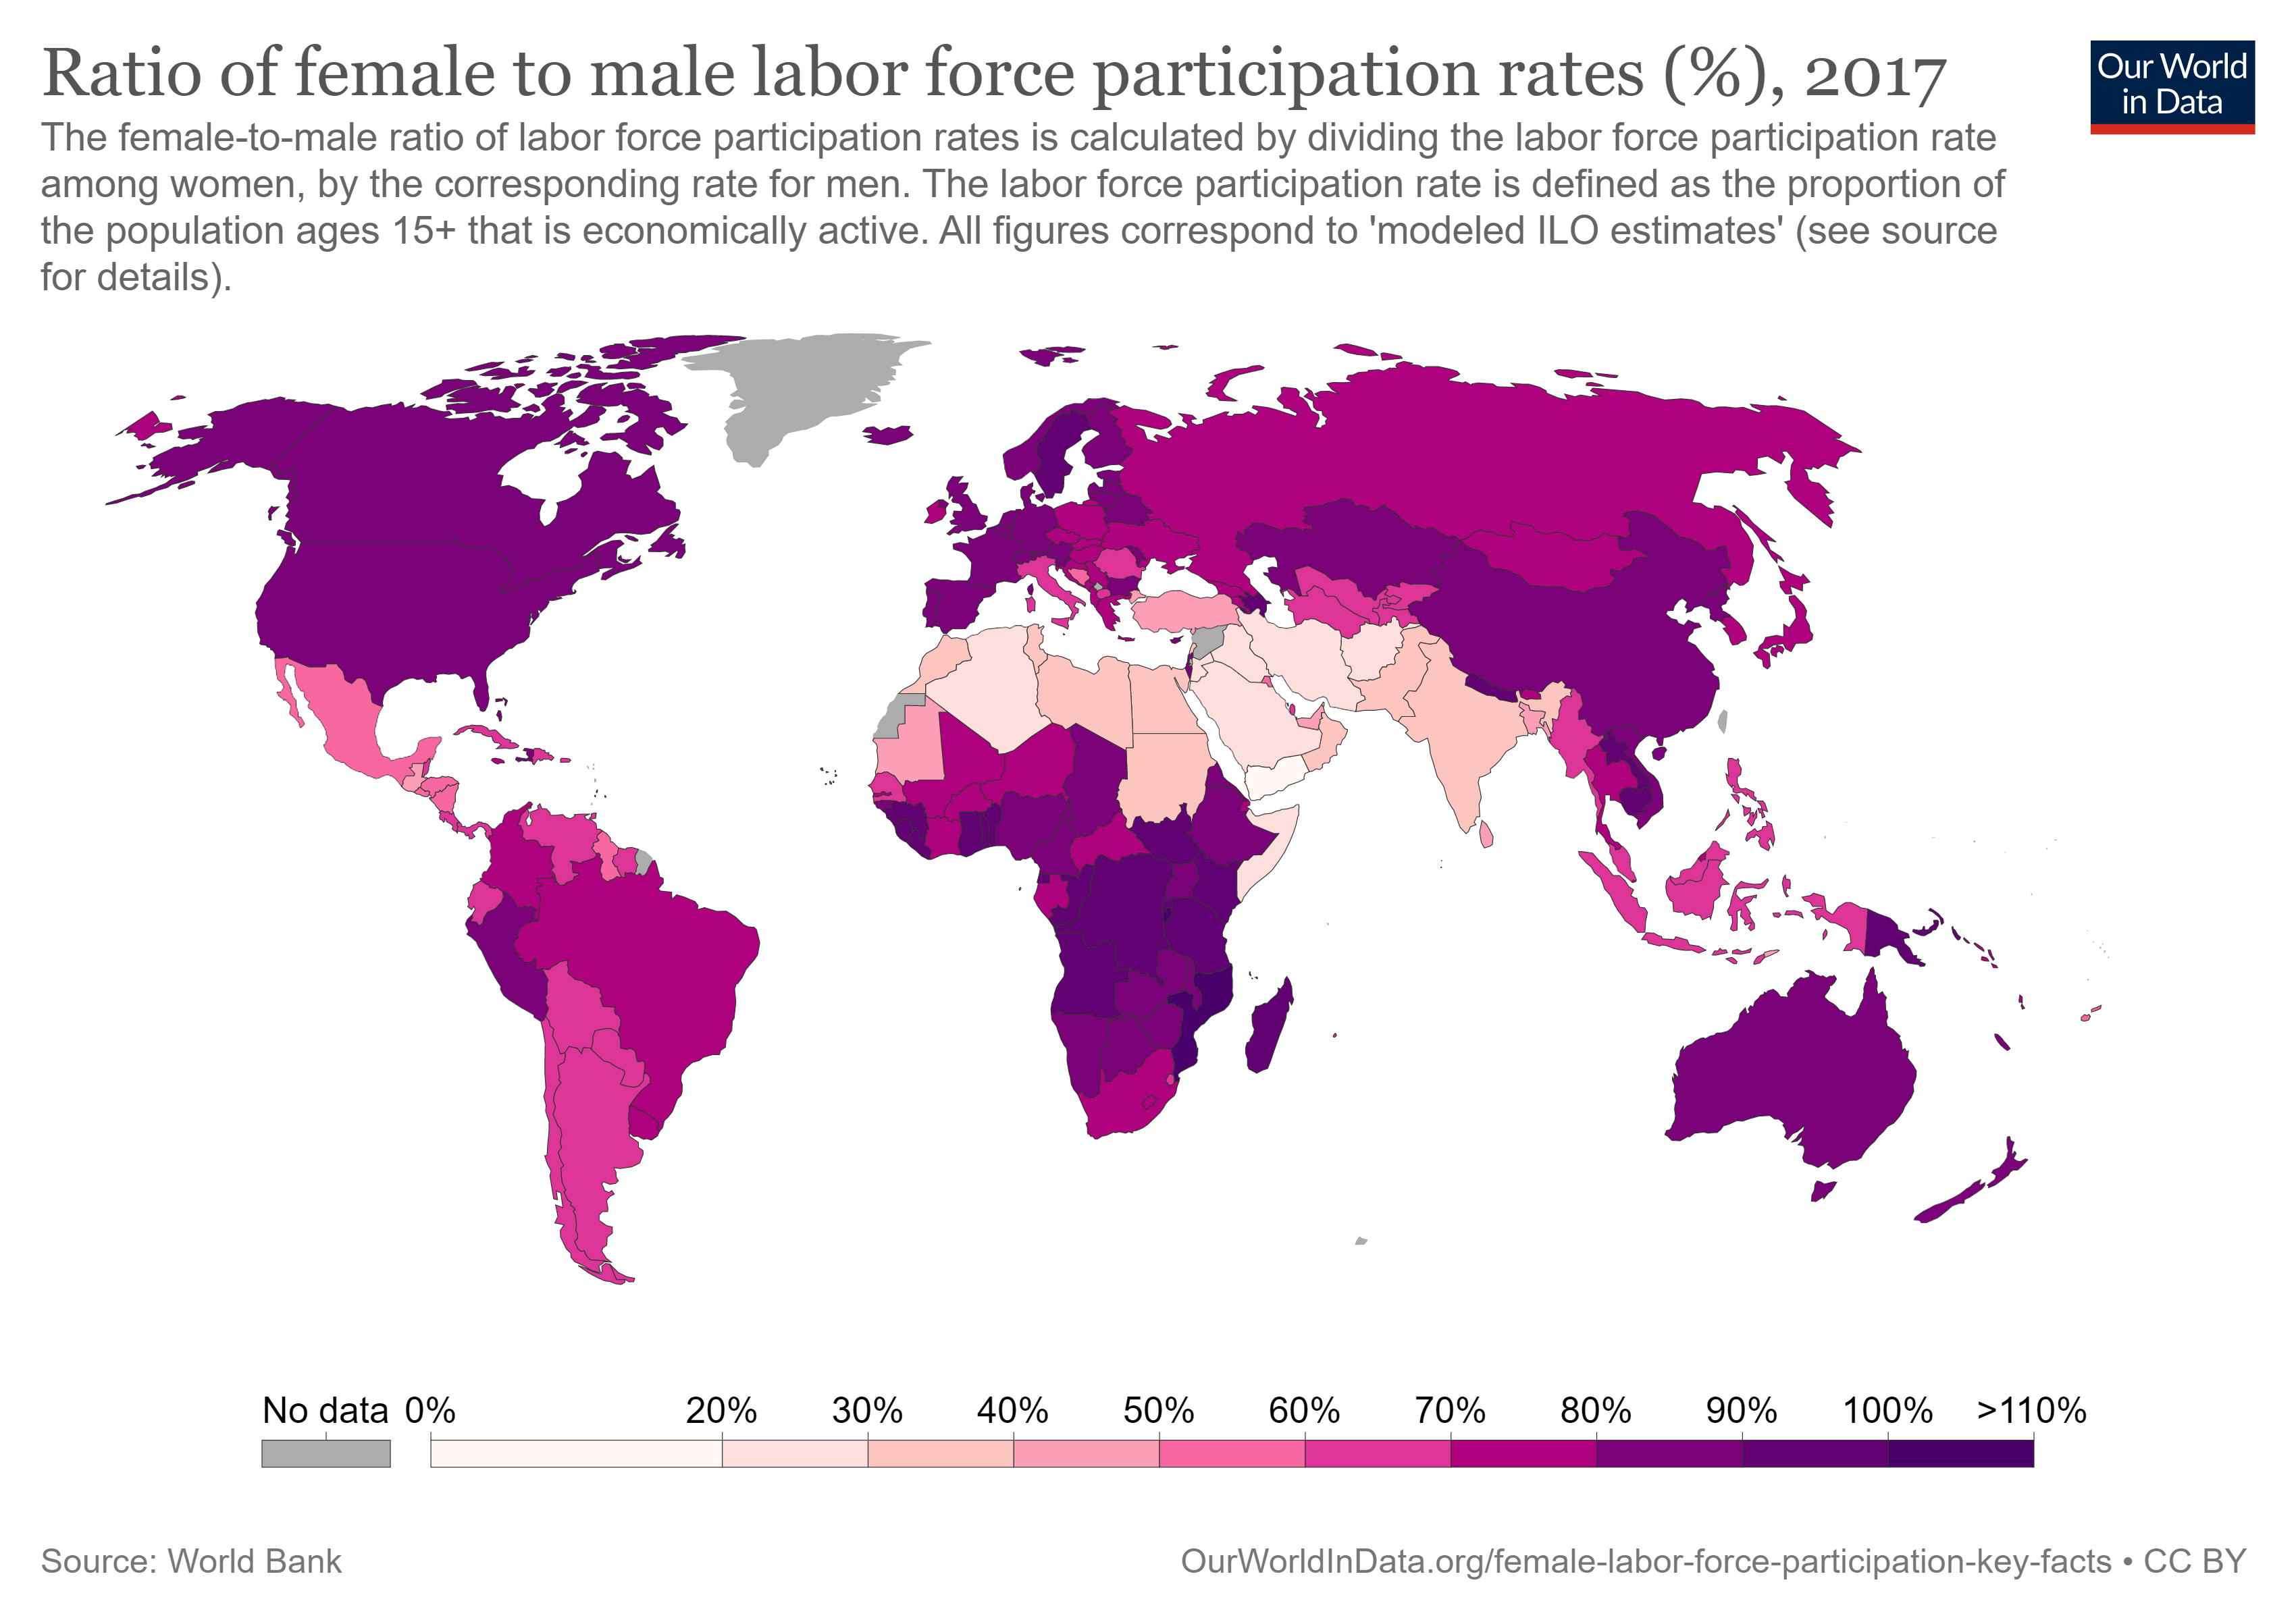

Slide 14
Correlation Table
 | Female labour Force Participation Rate | Maternal mortality ratio | Literacy Rate | Fertility rate
Female labour Force Participation Rate | 1
Maternal mortality ratio | 0.922634407 | 1
Literacy Rate | -0.863524892 | -0.973774249 | 1
Fertility rate | 0.915009545 | 0.988099755 | -0.990367893 | 1

Slide 15

Maternal Mortality Rate
Strong Positive Correlation
Dedication to work
Negligence Towards Health
Complexities During Pregnancy
Death
Literacy Rate
Strong Negative Correlation
Partiality in Posts
Lower Wages
Engagement in Primary Activities
Fertility Rate
Strong Positive Correlation
Increase in Population
Burden on Sustenance

Slide 16
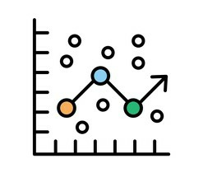
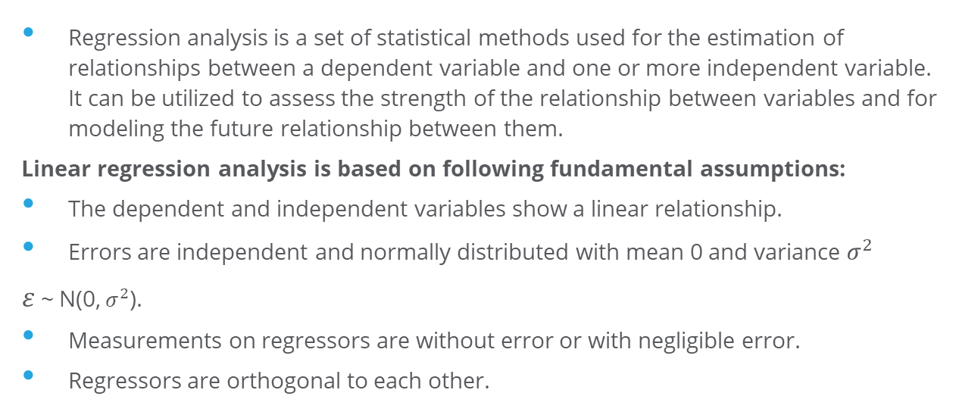
Regression Analysis
Regression analysis is a set of statistical methods used for the estimation of relationships between a dependent variable and one or more independent variable. It can be utilized to assess the strength of the relationship between variables and for modeling the future relationship between them.
Linear regression analysis is based on following fundamental assumptions:
The dependent and independent variables show a linear relationship.
Errors are independent and normally distributed with mean 0 and variance $σ^{2}$
$ε$ ~ N(0, $σ^{2}$).
Measurements on regressors are without error or with negligible error.
Regressors are orthogonal to each other.

Slide 17
Residual Plot

Slide 18
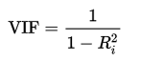
Presence of Multicollinearity
VIF :Variance inflation factor (VIF) is a measure of the amount of multicollinearity in a set of multiple regression variables.
Variable | VIF
MMR | 44.54
Literacy Rate | 54.96
Fertility Rate | 120.25

Slide 19

Ways to Deal with Non Constant Variance
Transformation
Weighted Least Square
The method of ordinary least squares assumes that there is constant variance in the errors. The method of weighted least squares can be used when the ordinary least squares assumption of constant variance in the errors is violated (which is called heteroscedasticity).
Data transformation may be used as a remedial measure to make data suitable for modeling with linear regression if the original data violates one or more assumptions of linear regression. Variance stabilizing transformation are used to meet the homogeneity of variance

Slide 20

PCR Technique
In statistics, Principal Component Regression (PCR) is a regression analysis technique that is based on Principal Component Analysis (PCA).
To sum up, the idea of PCA is simple — reduce the number of variables of a data set, while preserving as much information as possible.
In PCR, instead of regressing the dependent variable on the explanatory variables directly, the principal components of the explanatory variables are used as regressors. Major use of PCR lies in overcoming the multicollinearity problem & preventing loss of information.
Define Y: dependent variable = Female Labour Force Participation rate.
X1= Maternal Mortality Ratio, X2= Female Literacy Rate,
X3= Fertility Rate

Slide 21
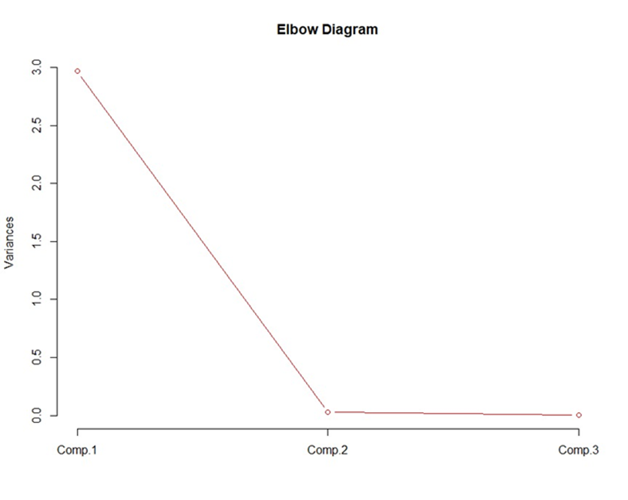
Implementation in R
Syntax- >princomp(data,cor=TRUE,score=TRUE)
The scree plot or elbow diagram is used to determine the number of factors to retain in principal components to keep in a principal component analysis (PCA).
Generally only the component above the elbow line are taken.

Slide 22
Interpretation
 | Comp.1 | Comp.2 | Comp.3
Standard deviation | 1.7228405 | 0.16219729 | 0.074246586
Proportion of Variance | 0.9893932 | 0.00876932 | 0.001837519
Cumulative Proportion | 0.9893932 | 0.99816248 | 1.000000000
It can be observed that first component is responsible to explain 98.9% of the data. Also the elbow diagram indicate that one variable is enough to explain variation. So we select first Principal Component thus reducing the dimension of our data from 3D to 1D with the help of PCA, preventing loss of information.

Slide 23
Loadings
Loadings are interpreted as the coefficients of the linear combination of the initial variables from which the principal components are constructed.
Since we have selected first Principal Component (Z)
Z= 0.576 X1 – 0.577 X2+ 0.579 X3
 | Comp1 | Comp2 | Comp3
X1 | 0.576 | 0.732 | 0.364
X2 | -0.577 | 0.680 | -0.453
X3 | 0.579 | - | -0.813

Slide 24
Syntax: >Regression=lm(formula=y~pc)
>Summary(Regression)
Regression Statistics
Multiple R | 0.8194
Adjusted R Square | 0.8112
Standard Error | 1.895
Observations | 24
 | Coefficient | Standard Error | t-stat | P-value
Intercept | 28.357709 | 0.3867537 | 73.3224 | 8.68E-28
Z | 2.242948 | 0.2244861 | 9.991479 | 1.23E-09

Slide 25
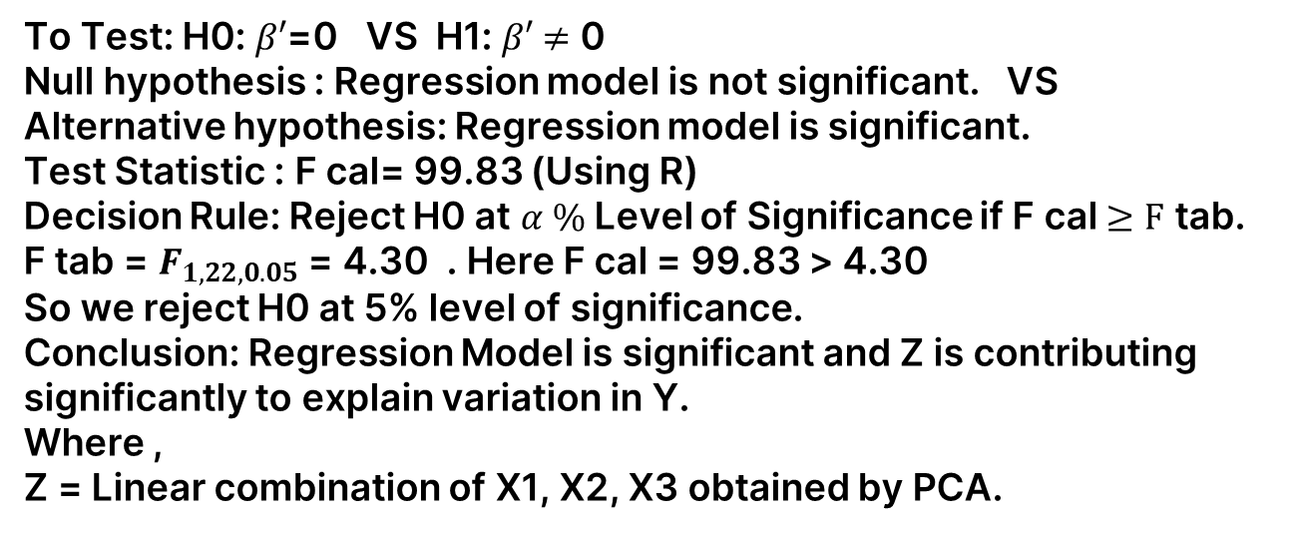
Testing Significance of Regression
To Test: H0: $β′$=0 VS H1: $β′$ $≠$ 0
Null hypothesis : Regression model is not significant. VS
Alternative hypothesis: Regression model is significant.
Test Statistic : F cal= 99.83 (Using R)
Decision Rule: Reject H0 at $α \%$Level of Significance if F cal $≥F$ tab.
F tab = $F_{1,22,0.05}$ = 4.30 . Here F cal = 99.83 > 4.30
So we reject H0 at 5% level of significance.
Conclusion: Regression Model is significant and Z is contributing significantly to explain variation in Y.
Where ,
Z = Linear combination of X1, X2, X3 obtained by PCA.

Slide 26
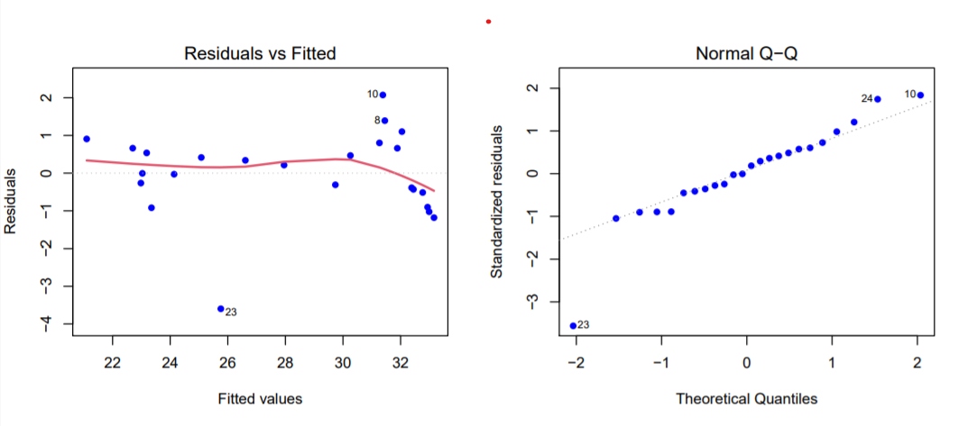
Residual Analysis
Normal QQ plot Shows that our data is from normal population.
Residual Plot: Here, most of the observation lies in horizontal bandwidth. The Residual line is nearly straight towards the start but as we move forward a slight fall can be seen. This is because the later observation differ largely than expected.

Slide 27
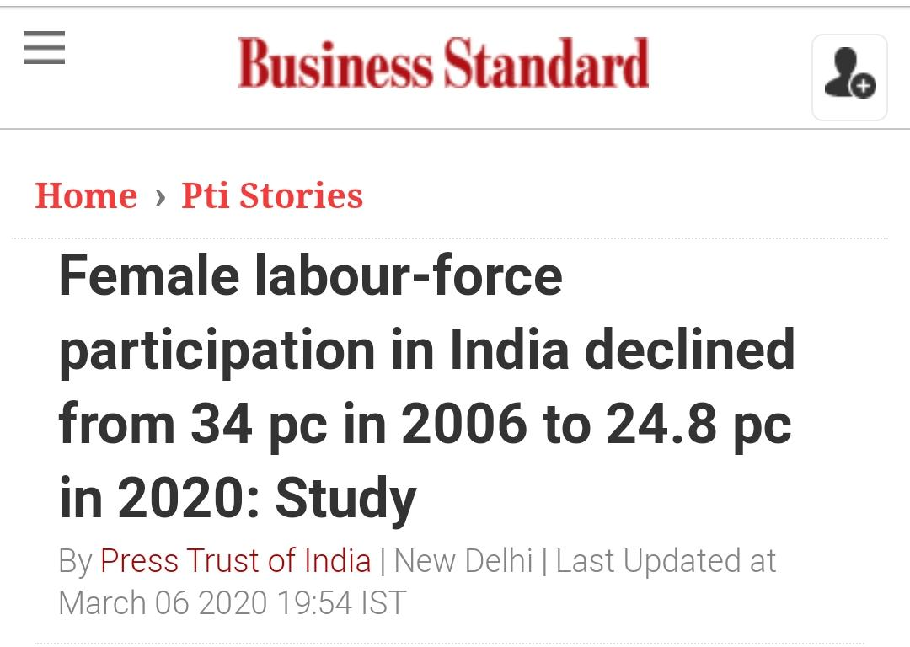
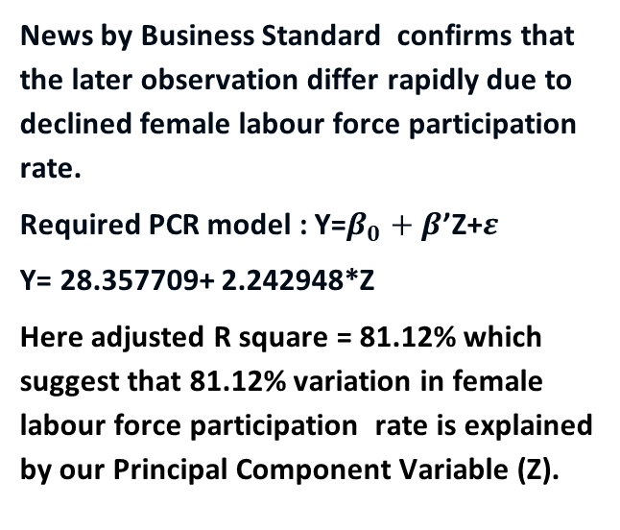
News by Business Standard confirms that the later observation differ rapidly due to declined female labour force participation rate.
Required PCR model : Y=$β_{0}+β$’Z+$ε$
Y= 28.357709+ 2.242948*Z
Here adjusted R square = 81.12% which suggest that 81.12% variation in female labour force participation rate is explained by our Principal Component Variable (Z).

Slide 28
Testing Of Hypothesis
Shapiro-Wilk Test in R Programming:
The Shapiro-Wilk's test or Shapiro test is a normality test in frequentist statistics. The null hypothesis of Shapiro's test is that the population is distributed normally.
It is among the three tests for normality designed for detecting all kinds of departure from normality.
If the value of p is equal to or less than 0.05,
then the hypothesis of normality will be rejected by the Shapiro test. On failing, the test can state that the data will not fit the distribution normally with 95% confidence.
However,on passing, the test can state that there exists no significant departure from normality. This test can be done very easily in R programming.
Implementation in R:
To perform the Shapiro Wilk Test, R provides Shapiro.test() function.
> # Syntax:
> shapiro.test(x)

Slide 29
Testing normality of maternal mortality rate:
we claim under H0 :data is from normal population
VS H1: data is from non normal population
let x= maternal mortality rate
>x=c(20.64,20.14,19.87,19.59,19.31,19.04,18.76,18.44,18.12,17.81,17.48,17.16,16.7,16.25,15.79,15.341,14.88,14.63,14.38,14.13,13.87,13.62,14.72,14.41)
> shapiro.test(x)
Shapiro-Wilk normality test
data: x
W = 0.92914, p-value = 0.09328
Interpretation:
Since, p value > 0.05 we can say that data is from normal population
Testing normality of literacy rate :
we claim under H0 :data is from normal population
VS H1: data is from non normal population
let y= Literacy rate
> y=c(45.3,46.7,48.35,50.75,52.31,53.79,54.7,56.02,58.3,59.45,61.2,62.2,63.82,64.33,65.2,65.78,66.72,67.32,68.12,69.44,70.21,71.22,73.22,73.38)

Slide 30
>shapiro.test(y)
Shapiro-Wilk normality test
data: y
W = 0.95002, p-value = 0.2712
Interpretation:
Decision: As p-value >0.05 we can say that data is from normal population
Testing normality fertility rate:
we claim under H0 :data is from normal population
VS H1: data is from non normal population
Let z= fertility rate
> z=c(3.582,3.514,3.446,3.379,3.311,3.244,3.176,3.109,3.041,2.972,2.899,2.823,2.743,2.661,2.581,2.506,2.439,2.381,2.333,2.295,2.266,2.243,2.222,2.035980237)
> shapiro.test(z)
Shapiro-Wilk normality test
data: z
W = 0.94516, p-value = 0.2123
Interpretation:
Decision: As p-value >0.05 we cany say that data is from normal population

Slide 31
Paired t-test
x= female labour force before the introduction of MNREGA scheme
y= female labour force after the introduction of MNREGA scheme
>x=c(31.97699928,31.99399948,32.01399994,32.03300095,32.06700134,32.2519989,32.54600143,32.84400177,33.14699936,33.45700073)
> >y=c(23.02700043,23.36100006,23.71999931,24.1060009,25.49500084,26.9489994,28.16699982,29.42499924,30.72400093,31.96500015)
Firstly we test the assumption of paired t test i.e. normality of the difference by shapiro wilk test
> x-y
[1] 8.949999 8.632999 8.294001 7.927000 6.572000 5.302999 4.379002 3.419003 2.422998 1.492001
>z=c(8.949999,8.632999,8.294001,7.927000,6.572000,5.302999,4.379002,3.419003,2.422998,1.492001)
Shapiro-Wilk normality test data:
>shapiro.test(z)
>z = 0.91842, p-value = 0.344
Since p-value >0.05 we can say that differences are normally distributed with 95% Confidence interval.
To test under H0:z=0
VS H1:z<0

Slide 32

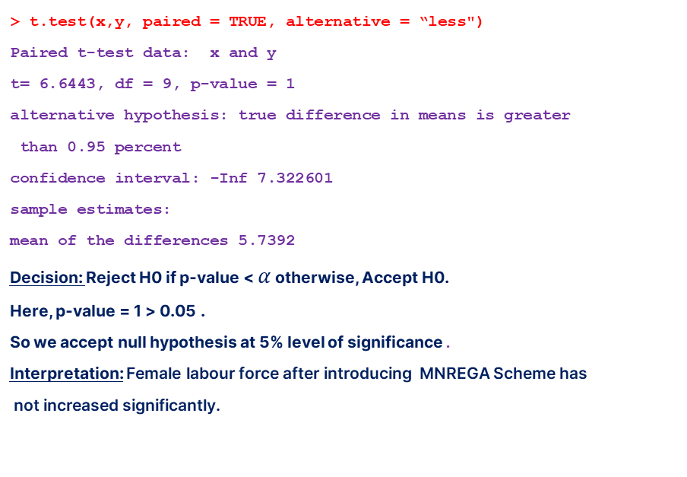
> t.test(x,y, paired = TRUE, alternative = “less")
Paired t-test data: x and y
t= 6.6443, df = 9, p-value = 1
alternative hypothesis: true difference in means is greater
than 0.95 percent
confidence interval: -Inf 7.322601
sample estimates:
mean of the differences 5.7392
Decision: Reject H0 if p-value < $α$ otherwise, Accept H0.
Here, p-value = 1 > 0.05 .
So we accept null hypothesis at 5% level of significance.
Interpretation: Female labour force after introducing MNREGA Scheme has
not increased significantly.

Slide 33




SWOT Analysis
Strengths
Weaknesses
S
W
Gender Inequality
Failure of Govt. Schemes
Under Utilisation
Demand Skill Mismatch
Lack of Security
Financial Independence
Gaining Confidence & Respect
Job Providers
Rise in Women Entrepreneurship
Opportunities
O
T
Threats
Gender Focused Planning
Policy Approach
Promoting Entrepreneurship
Creating Safe Nation
Fem- U
High Unemployment Rate
Inferior FLPR
SDG-5 & 8 a Far Fetched Goal
Positive Factors Having Negative Impact

Slide 34
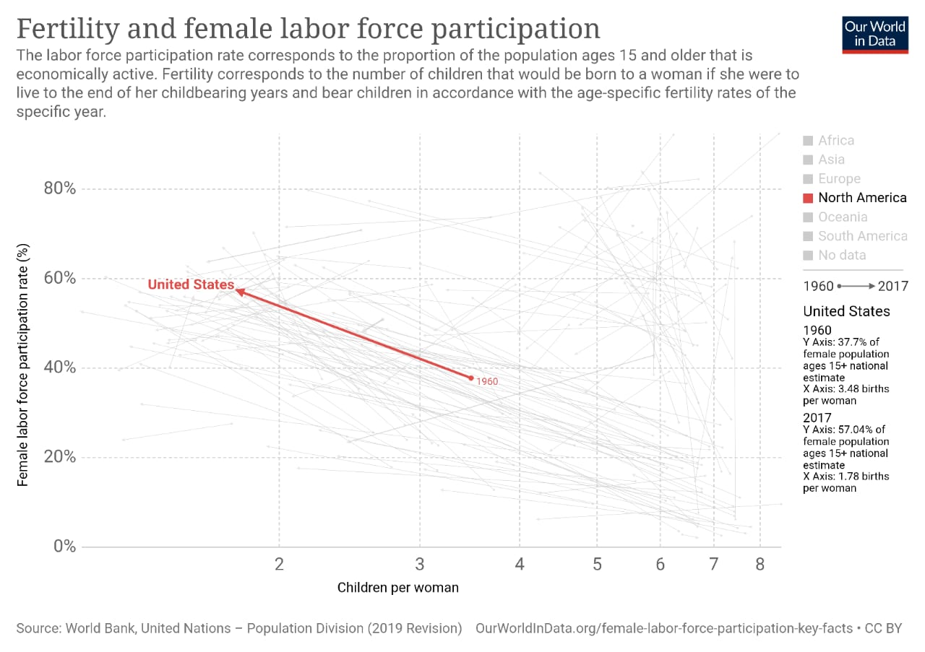
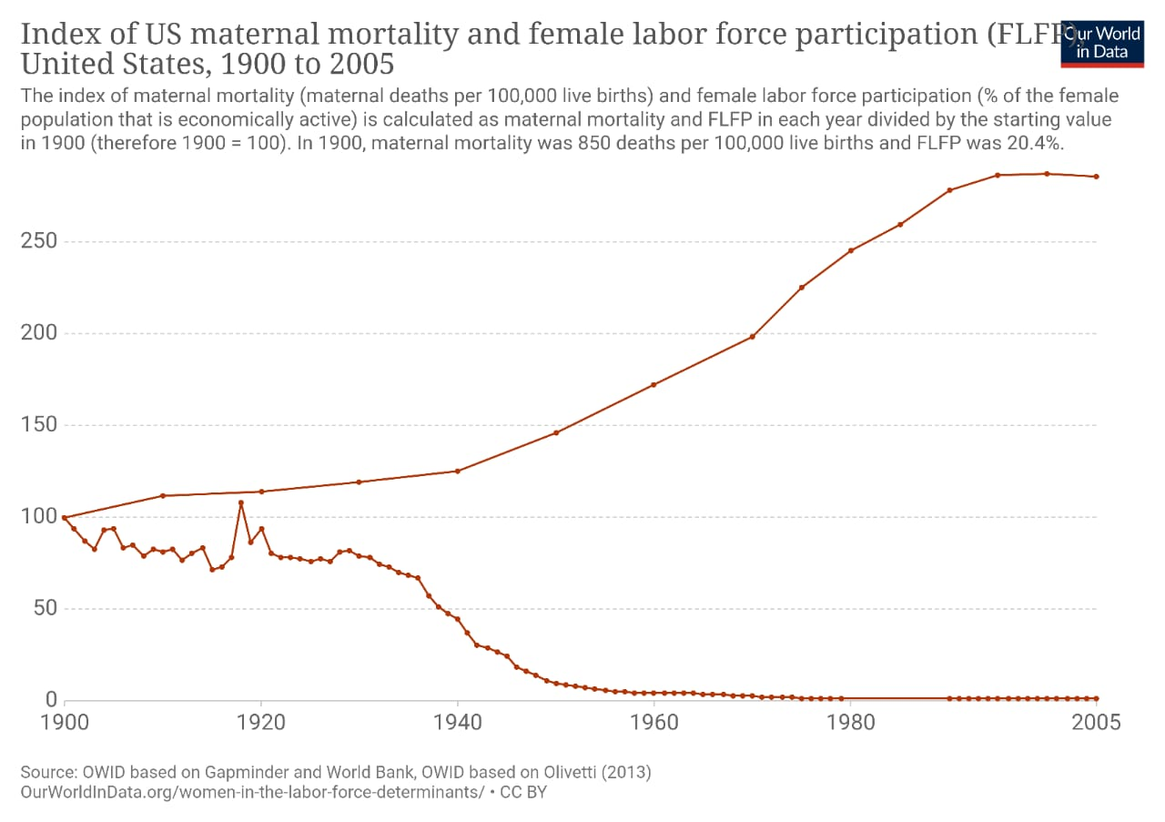
What is expected ?

